Slide 1
Banking Application Capstone Presentation
Radwa Aboudina

Slide 2
Part 1: Front-End Architecture, Authentication, And App Diagram

Slide 3
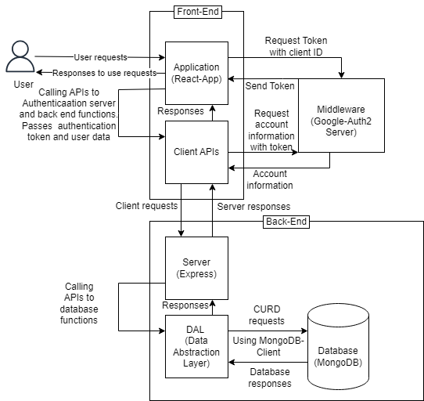
Application Overview Diagram

Slide 4
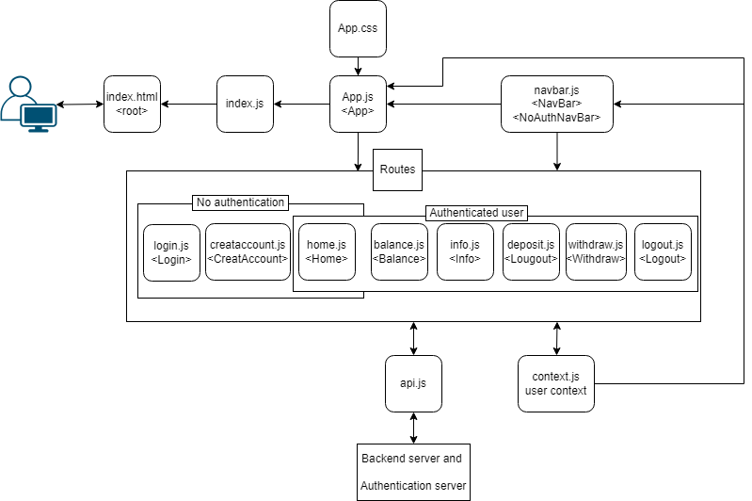
Front-End Architecture – Component Architecture Diagram

Slide 5
Front-End Architecture – UI Design Decisions
Styling using react bootstrap
All pages and forms are displayed in react bootstrap card components
The navigation bar shows the functions available to the user based on the user authentication status.
The basic functions are available in the navigation bar and there are also links in every page that lead to the user possible next required functions.
Success messages or welcome messages are displayed to the user with every response to a user request.
Errors are displayed to the users in the form of alert windows.

Slide 6
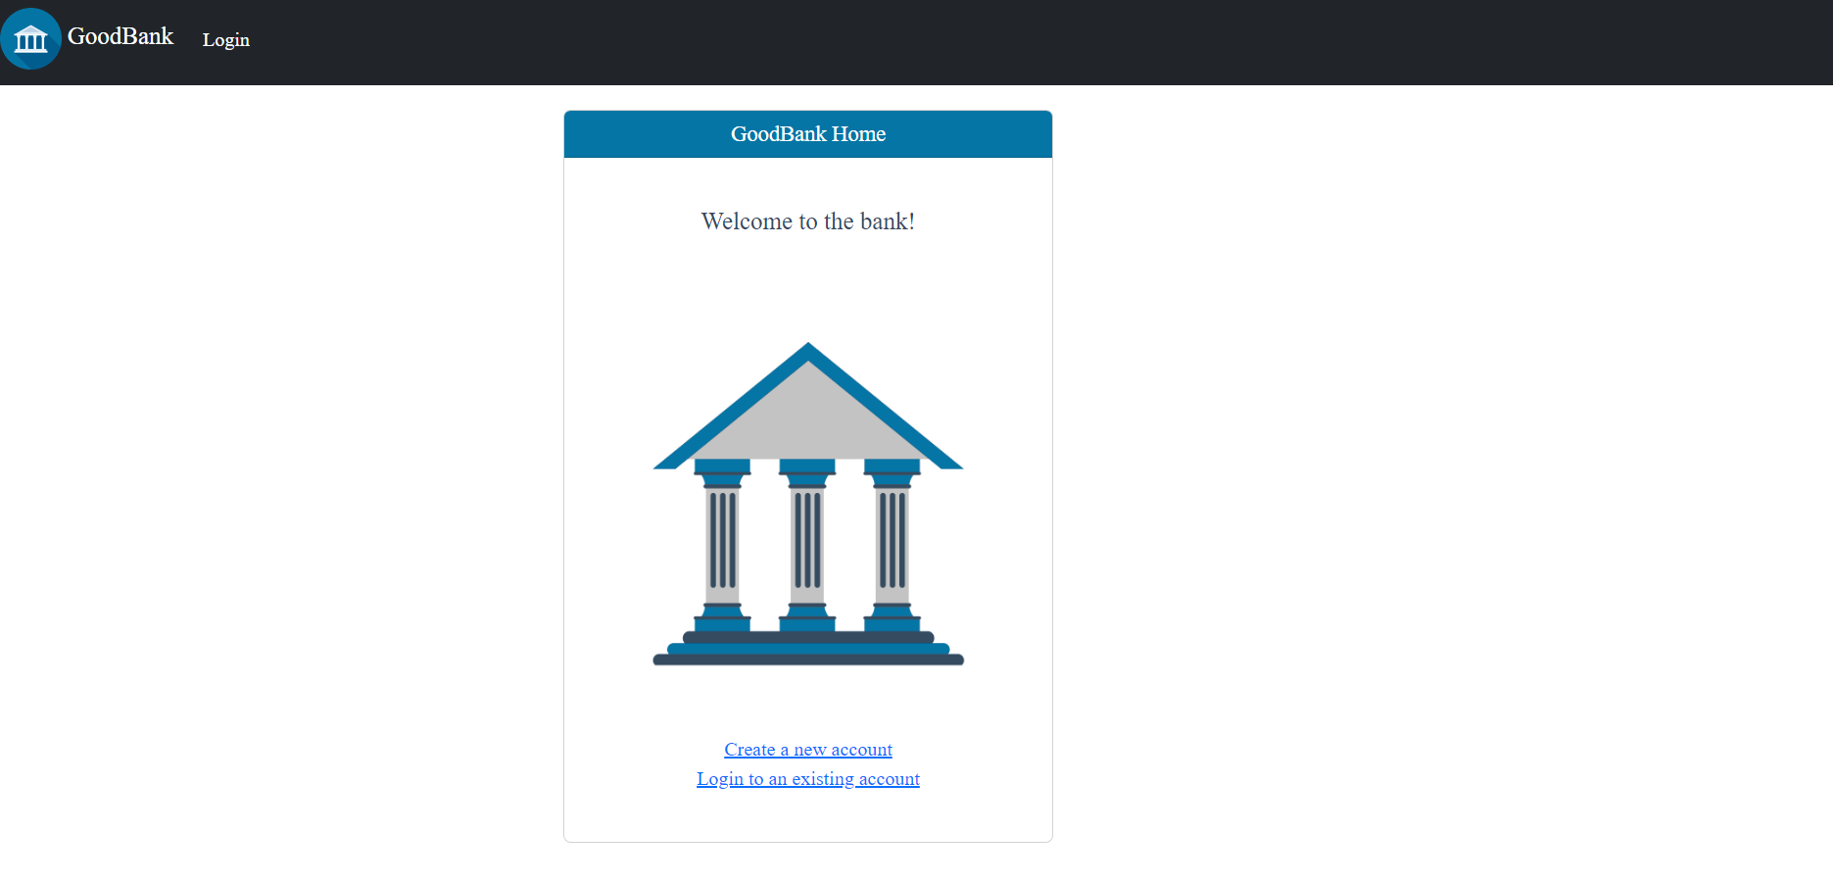
Front-End Architecture – UI Design Decisions
Styling using react bootstrap
All pages and forms are displayed in react bootstrap card components

Slide 7

Front-End Architecture – UI Design Decisions
The navigation bar shows the functions available to the user based on the user authentication status.

Slide 8
Front-End Architecture – UI Design Decisions
The basic functions are available in the navigation bar and there are also links in every page that lead to the user possible next required functions.

Slide 9
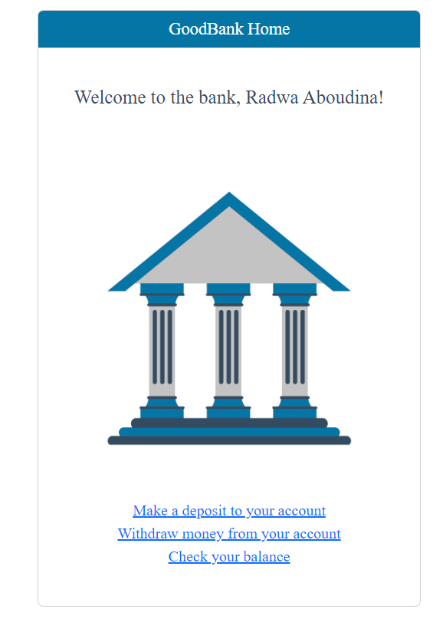
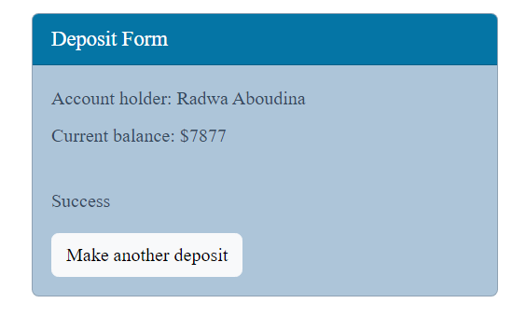
Front-End Architecture – UI Design Decisions
Success messages or welcome messages are displayed to the user with every response to a user request.

Slide 10
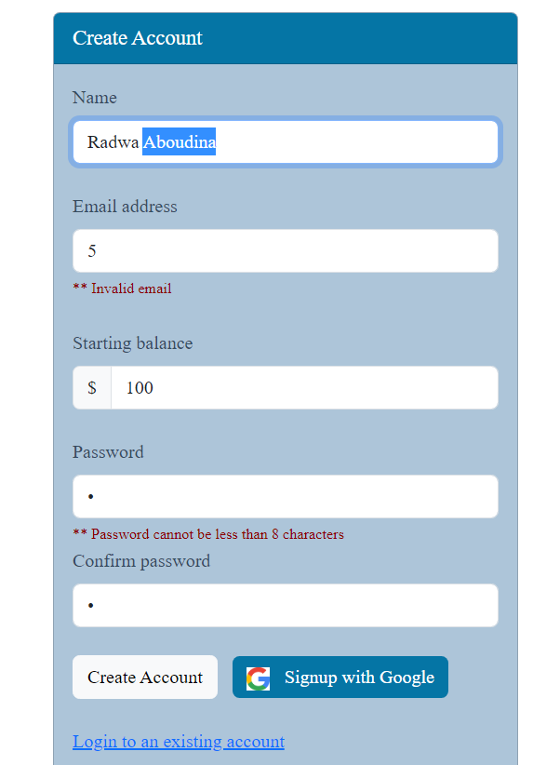
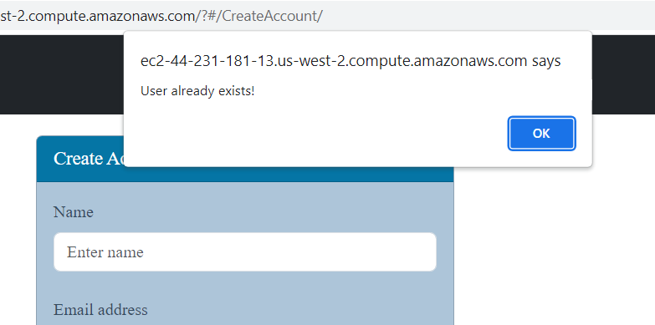
Front-End Architecture – UI Design Decisions
Errors are displayed to the users in the form of alert windows and error messages under invalid fields.

Slide 11
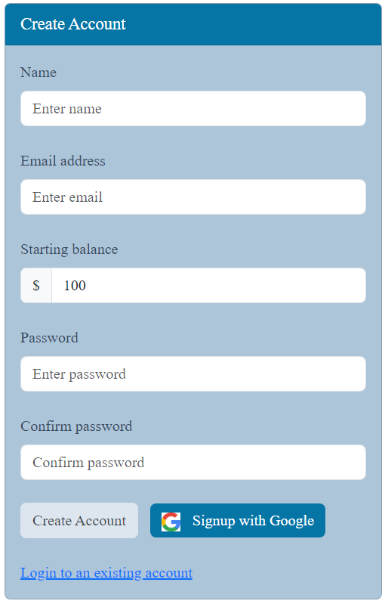
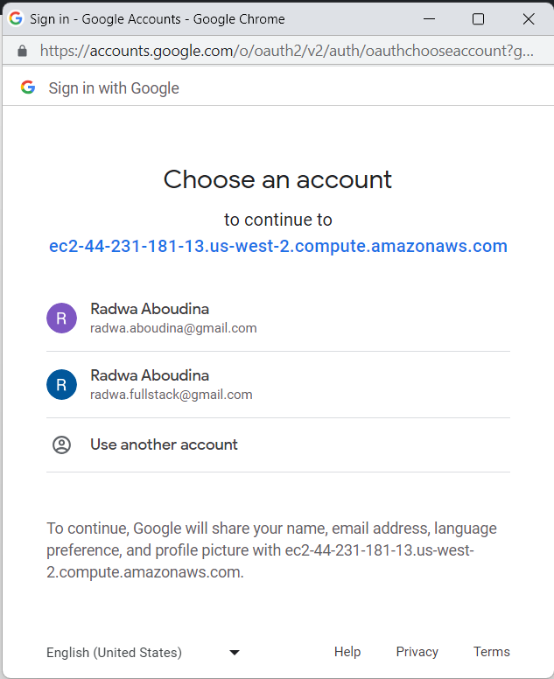
Authentication – Signing up
Methods of Authentication
User name and password
Google OAuth

Slide 12
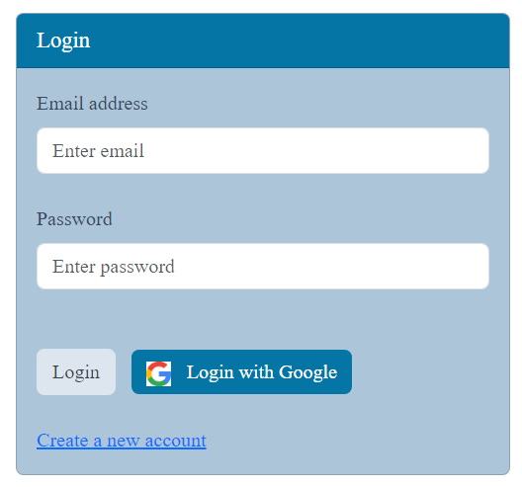
Authentication – Loging in
Methods of Authentication
User name and password
Google OAuth

Slide 13
Authentication – Challenges & Solutions
Challenge: At first I ran the database on docker.
No access outside of local machine, after website was deployed.
Had to keep docker desktop running.
Solution: I ran the database on MongoDB Atlas which provided me with a URL that is always running and I could use anywhere

Slide 14
Authentication – Challenges & Solutions
Challenge: At first I ran the database on docker.
No access outside of local machine, after website was deployed.
Had to keep docker desktop running.
Challenge: The Google authentication server kept denying my access requests.
Solution: I ran the database on MongoDB Atlas which provided me with a URL that is always running and I could use anywhere
Solution: Found out I needed authorize my local server URL on Google API manager, by adding it to the list of authorized URLs in my Client ID console. I also added my deployed website URL.

Slide 15
Part 2: Database And API

Slide 16
Database

Slide 17
API

Slide 18
Part 3: Deployment, Additional Features, App Demonstration, Reflection

Slide 19
Deployment

Slide 20
Additional Features

Slide 21
Application Demonstration – Create Account, Log In, Deposit, Withdraw

Slide 22
Reflection

